Slide 1
Vacation Website
- Front End Project by Ashwini Harish Poojary

Slide 2
Introduction:
The Vacation Planning Website Project is designed to simplify the process of organizing and booking trips. This platform allows users to explore destinations, plan itineraries, and book accommodations and activities all in one place.

Slide 3
Technology Used:
HTML
CSS
Bootstrap

Slide 4
Features
User-Friendly UI
Multiple holiday package
Check Reviews and Ratings

Slide 5
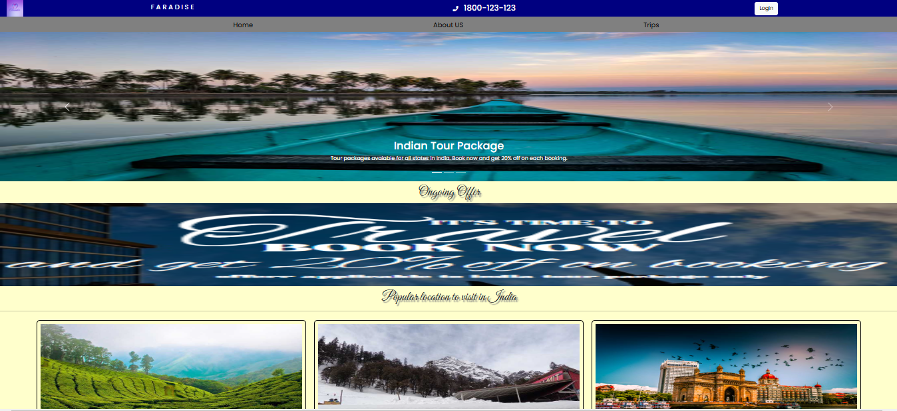
User Interface

Slide 6
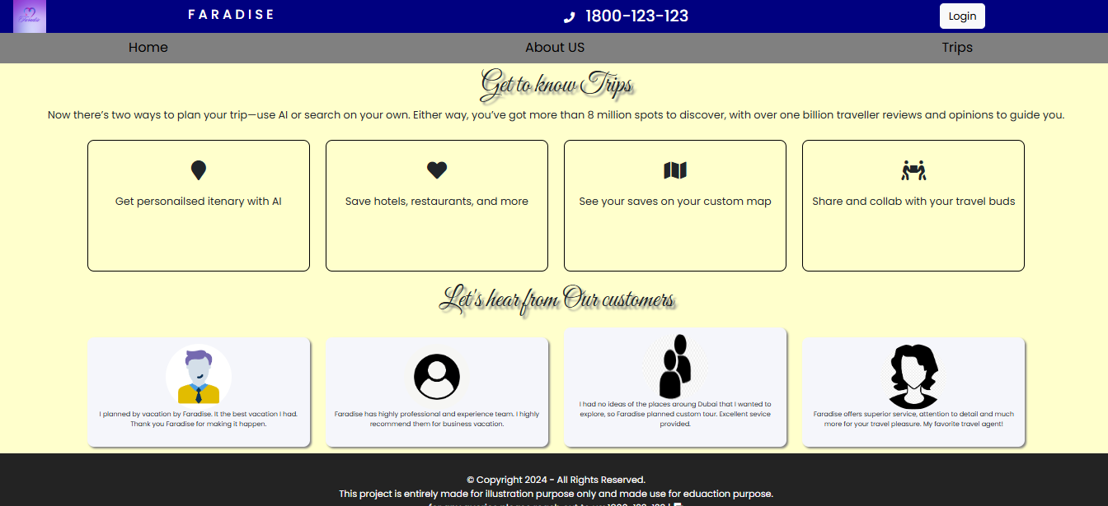
Review page

Slide 7
Thank You

